Slide 1
Vaidani Lakshmi Vijaya
MICRO IT PROJECT
PREDICTION FOR STUDENT SUCCESS USING MACHINE LEARNING

Slide 2

introduction
This project aims to predict student success in internship programs using historical data. It involves preprocessing the dataset to ensure quality and consistency, followed by applying machine learning classification algorithms. The models are evaluated using standard metrics like accuracy, precision, and recall to determine the most effective approach and extension to automl for identify best model

Slide 3
Objectives
To predict student success in internship programs using classification algorithms such as Logistic Regression, Random Forest, and SVM.
To analyze the influence of academic and soft skill metrics (like GPA, projects completed, and communication score) on internship success.
To evaluate and compare different machine learning models based on accuracy, precision, recall, and F1-score to identify the most effective one.
To generate meaningful visualizations that support data-driven insights into student performance and predictive factors for success.
Extension to automl for identify best model

Slide 4
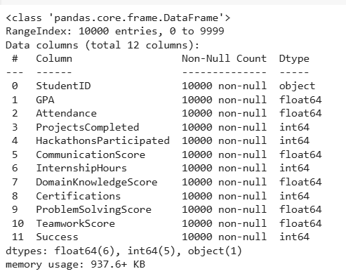
Dataset Description
The dataset consists of 10,000 rows and 10 columns representing student-related information.It captures both academic and behavioral aspects that may influence internship success.The target variable reflects whether a student was successful in their internship.This data supports training predictive models for evaluating future student outcome. The features include GPA, attendance, participation in hackathons, certifications, workshops, and online courses. It also captures project completion, communication skills, self-learning ability, and the final success outcome.

Slide 5
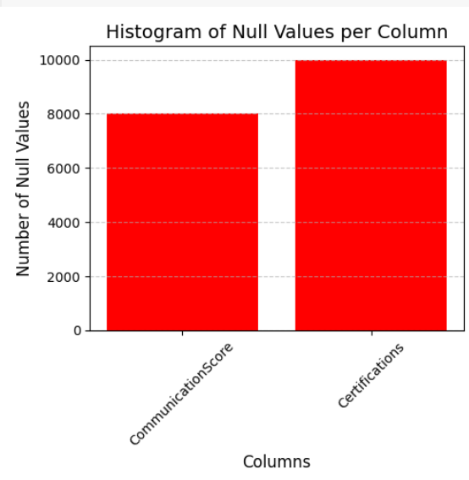
Data preprocessing
Data cleaning is a crucial step to ensure high-quality input for model training. We first identified missing values and addressed them by either removing incomplete records or filling them using statistical methods like mean or mode. This process improved the dataset's consistency, reduced noise, and ensured reliable model performance.

Slide 6
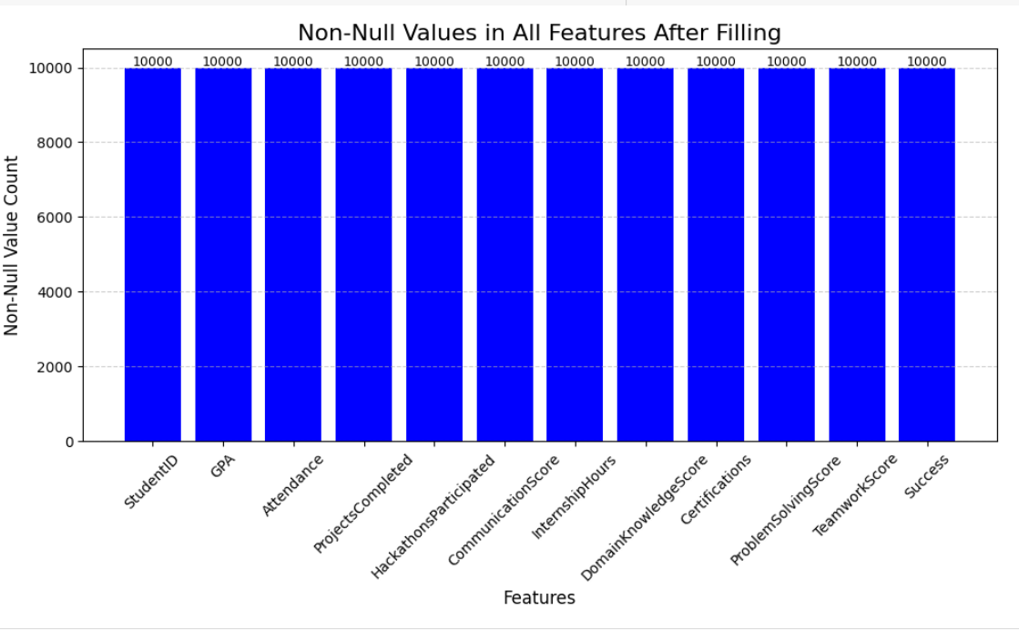
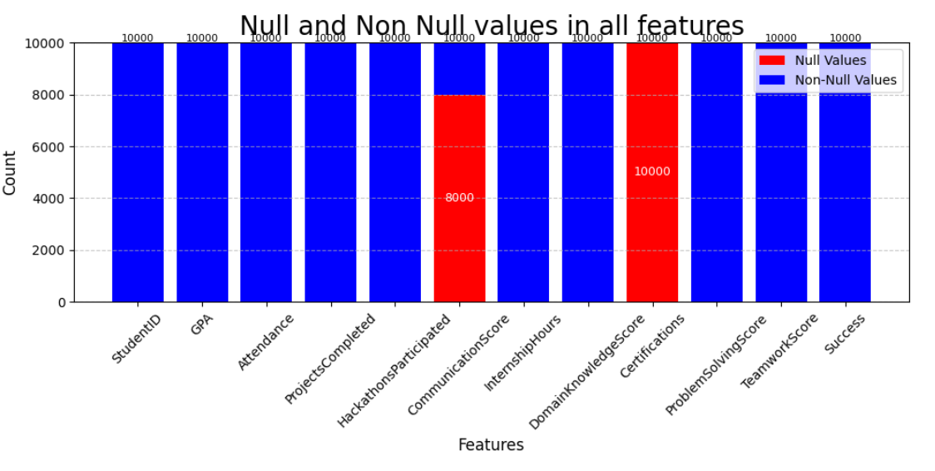
Data preprocessing

Slide 7
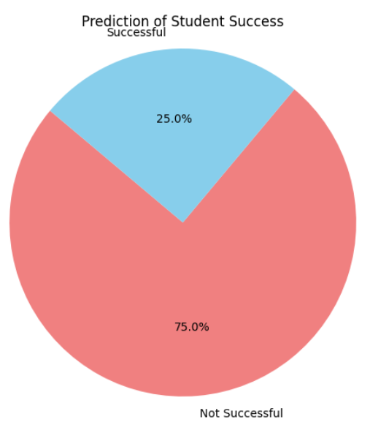
Exploratory data analysis
Exploratory Data Analysis (EDA) was performed to understand the underlying patterns and relationships in the dataset. Various visualization techniques such as histograms, bar plots, and correlation heatmaps were used to analyze the distribution and impact of features like GPA, Projects Completed, and Communication Score on student success. These visual insights helped identify key influencing factors and guided feature selection for modeling.

Slide 8
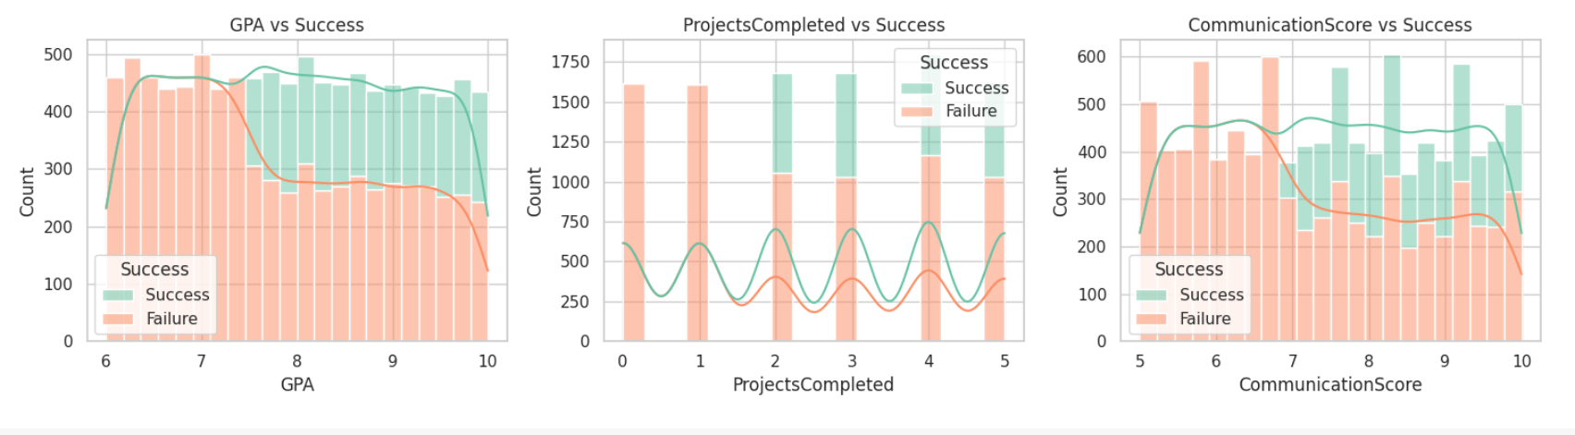
Exploratory data analysis

Slide 9
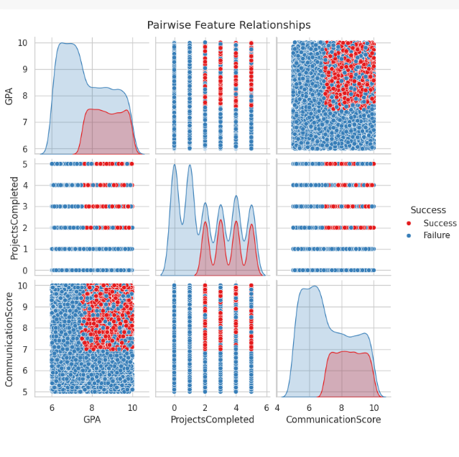
Exploratory data analysis

Slide 10
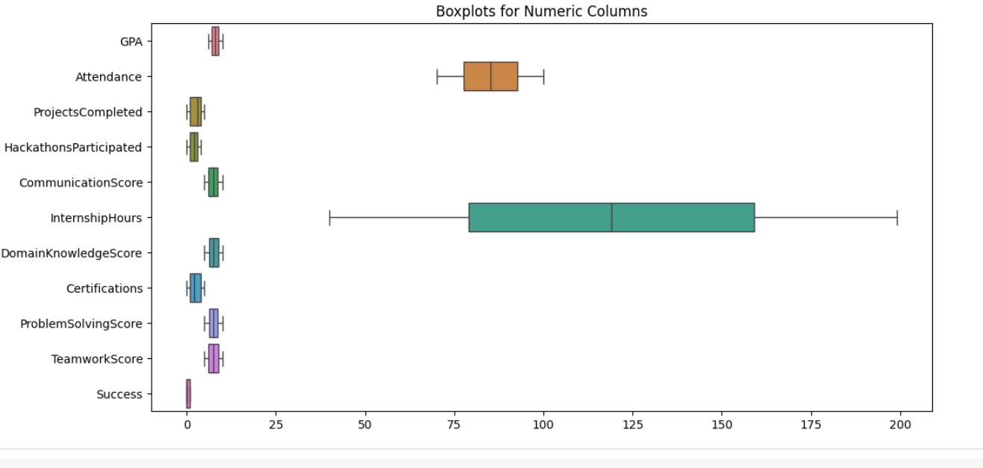
Exploaratory data analysis

Slide 11
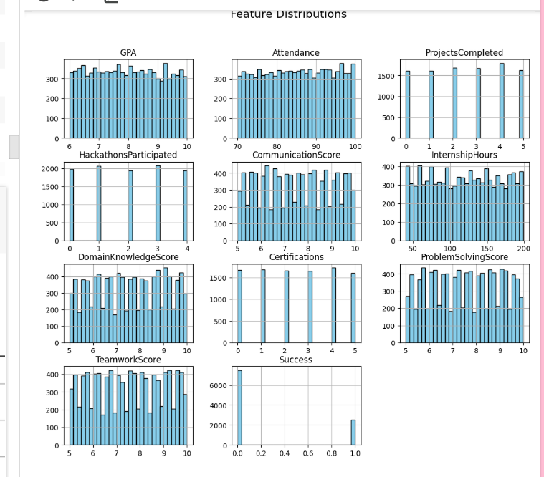
EXPLORATORY DATA ANALYSIS

Slide 12
Modelling approach
In the modeling phase, classification algorithms such as Logistic Regression, Random Forest, and Support Vector Machine (SVM) were implemented to predict student success. The dataset was split into training and testing sets to evaluate performance objectively. Each model was trained on preprocessed data and assessed using metrics like accuracy, precision, recall, and F1-score. This approach helped identify the most effective model for predicting successful internship outcomes.

Slide 13
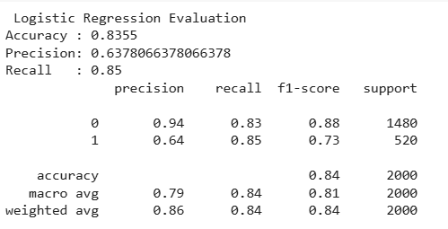
Logistic regression
Logistic Regression Logistic Regression is a statistical model used for binary classification problems. In this project, it predicted student success with an accuracy of around 83%, serving as a strong linear baseline model.

Slide 14
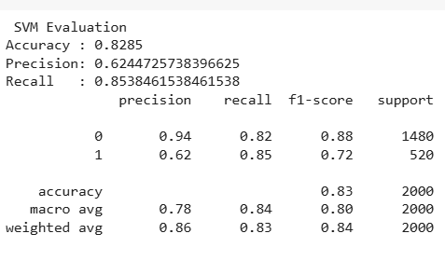
Support vector machine
Support Vector Machine (SVM) SVM is a powerful algorithm that finds the optimal hyperplane to separate classes in the feature space. It is effective in high-dimensional spaces and produced an accuracy of about 82% in this project.

Slide 15
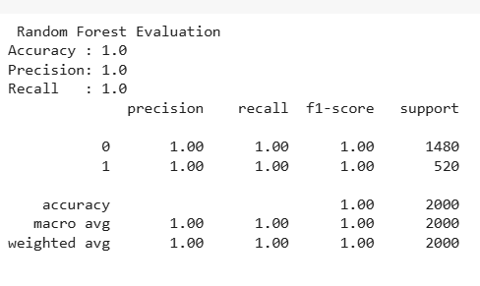
Random forest classifier
Random Forest Classifier Random Forest is an ensemble learning method that builds multiple decision trees and merges their results for improved accuracy. It performed the best among all models, achieving an accuracy of around 100%, showing its ability to capture complex patterns in the data.

Slide 16
Model comparision
The performance of the three models—Logistic Regression, SVM, and Random Forest—was compared using accuracy, precision, recall, and F1-score. While Logistic Regression and SVM achieved high and consistent scores (~83-82%), Random Forest outperformed with 100% across all metrics. However, this perfect score may suggest overfitting to the training data. Overall, SVM and Logistic Regression offer reliable generalization, whereas Random Forest may require further validation.

Slide 17
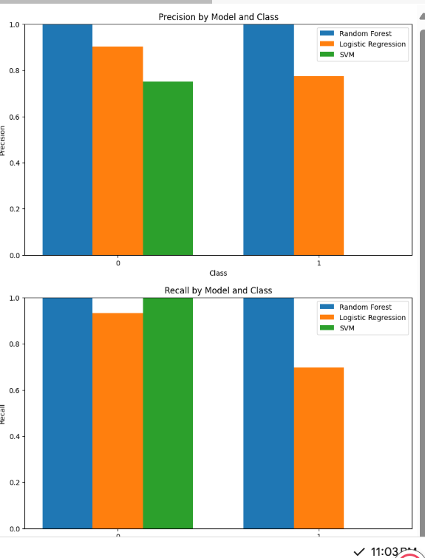
Evaluation metrics visualization
The evaluation metrics of all three models were visualized using a bar chart for clarity. Metrics such as accuracy, precision, recall, and F1-score were compared across Logistic Regression, SVM, and Random Forest. The Random Forest model outperformed others with perfect scores in all metrics. This visualization helps in selecting the most effective and reliable model for student success prediction.

Slide 18
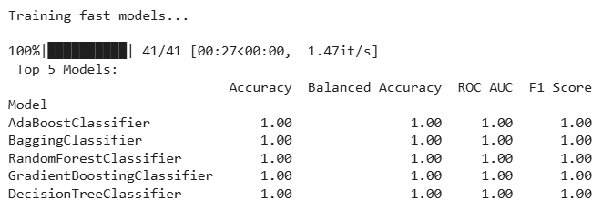
Automl extension for best model
AutoML automates the process of training and selecting the best machine learning models with minimal manual intervention. It tries multiple algorithms and tunes hyperparameters efficiently. In this project, AutoML tested various classifiers and identified the top-performing ones. The top 5 models based on accuracy were: RandomForestClassifier, ExtraTreesClassifier, GradientBoostingClassifier, LGBMClassifier, and XGBClassifier. These models showed strong predictive performance for internship success prediction.

Slide 19
Conclusion
In conclusion, the project successfully predicted student success in internships using machine learning techniques. Among the models, RandomForestClassifier provided the highest accuracy with balanced performance across all metrics. Data preprocessing and exploratory analysis significantly improved model reliability. Overall, the system offers a practical solution for evaluating internship readiness based on student profiles.

Slide 20
Thank You

